Slide 1

IS 253 OBJECT ORIENTED PROGRAMMING
LECTURE 4 & PRACTICALS

Slide 2
OBJECTIVES
Understanding Inheritance.
Exploring Inheritance case studies through examples.
Understanding the behavior of constructors in inheritance.
Understanding method overriding.
Understanding the fundamental difference between Method overriding and overloading.

Slide 3
INTRODUCTION
You use a class to model objects of the same type.
Different classes may have some com-mon properties and behaviors, which can be generalized in a class that can be shared by other classes.
You can define a specialized class that extends the generalized class.
The specialized classes inherit the properties and methods from the general class.
Inheritance enables you to define a general class i.e. superclass and later extend it to more specialized classes i.e. subclasses

Slide 4
INTRODUCTION TO INHERITANCE
You use a class to model objects of the same type.
Different classes may have some com-mon properties and behaviors, which can be generalized in a class that can be shared by other classes.
You can define a specialized class that extends the generalized class.
The specialized classes inherit the properties and methods from the general class.
Inheritance enables you to define a general class i.e. superclass and later extend it to more specialized classes i.e. subclasses

Slide 5
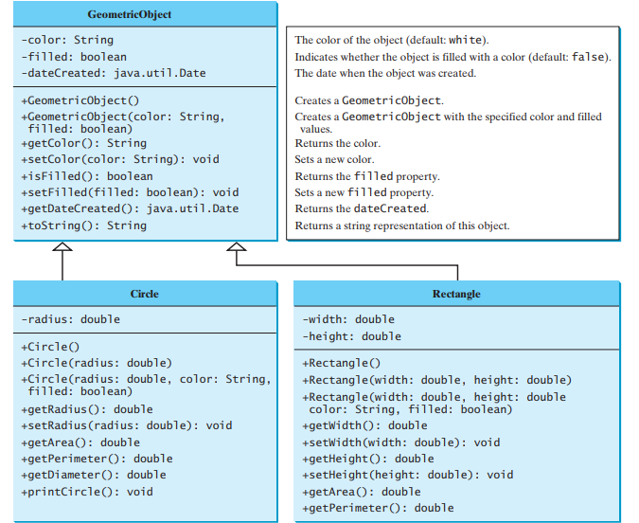
INHERITANCE:USE CASE

Slide 6
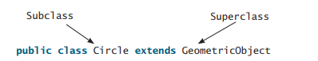
INHERITANCE:USE CASE
A triangular arrow pointing to the superclass is used to denote the inheritance relationship between the two classes involved.
In Java terminology, a class C1 extended from another class C2 is called a subclass, and C2 is called a superclass.
A superclass is also referred to as a parent class or a base class, and a subclass as a child class, an extended class, or a derived class.
In order to inherit from a class in JAVA, the keyword extends is used

Slide 7
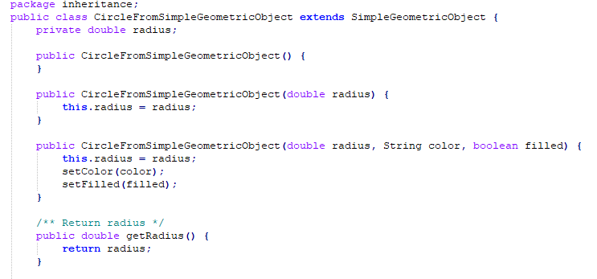
INHERITANCE:USE CASE
Consider the extracted code below:

Slide 8
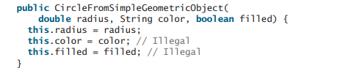
INHERITANCE:USE CASE
You might attempt to use the data fields color and filled directly in the constructor, but that is not allowed, those members can only be accessed in the GeometricObject class.
They cannot be accessed in any class other than in the GeometricObject class itself.
The only way to read and modify color and filled is through their getter and setter methods.

Slide 9
INHERITANCE
Contrary to the conventional interpretation, a subclass is not a subset of its superclass.
A subclass usually contains more information and methods than its superclass.
Private data fields in a superclass are not accessible outside the class. Therefore, they cannot be used directly in a subclass.
Private data fields can be accessed/mutated through public accessors/mutators if defined in the superclass.

Slide 10
INHERITANCE
Not all is-a relationships should be modeled using inheritance.
For example: a square is a rectangle, but you should not extend a Square class from a Rectangle class, because the width and height properties are not appropriate for a square. Instead, you should define a Square class to extend the GeometricObject class and define the side property for the side of a square.
Do not blindly extend a class just for the sake of reusing methods.
For example: it makes no sense for a Tree class to extend a Person class, even though they share common properties such as height and weight. A subclass and its superclass must have the is-a relationship. Example: A cow is an animal. A Circle is a Geometric Object

Slide 11
MULTIPLE INHERITANCE
Some programming languages allow you to derive a subclass from several classes.
This capability is known as multiple inheritance.
Java, however, does not allow multiple inheritance.
A Java class may inherit directly from only one superclass.
This restriction is known as single inheritance.
If you use the extends keyword to define a subclass, it allows only one parent class.
Nevertheless, multiple inheritance can be achieved through interfaces

Slide 12
USING THE “SUPER” KEYWORK
The keyword super refers to the superclass and can be used to invoke the superclass’s methods and constructors.
Unlike properties and methods, the constructors of a superclass are not inherited by a subclass.
Constructors of a superclass can only be invoked from the constructors of the subclasses using the keyword super.
The syntax to call a superclass’s constructor is: super(); or super(parameters);

Slide 13
USING THE “SUPER” KEYWORK
The statement super() invokes the no-arg constructor of its superclass.
The statement super(arguments) invokes the superclass constructor that matches the arguments.
The statement super() or super(arguments) must be the first statement of the subclass’s constructor; this is the only way to explicitly invoke a superclass constructor.

Slide 14
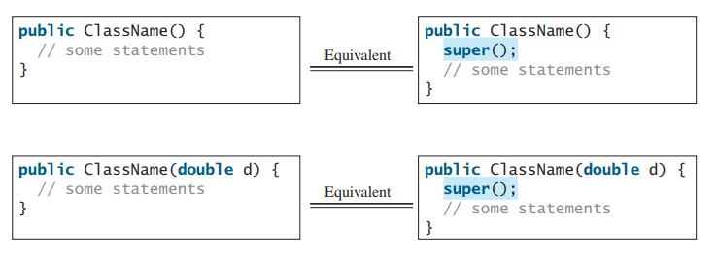
INHERITANCE: CONSTRUCTOR CHAINING
A constructor may invoke an overloaded constructor or its superclass constructor.
If neither is invoked explicitly, the compiler automatically puts super() as the first statement in the constructor

Slide 15
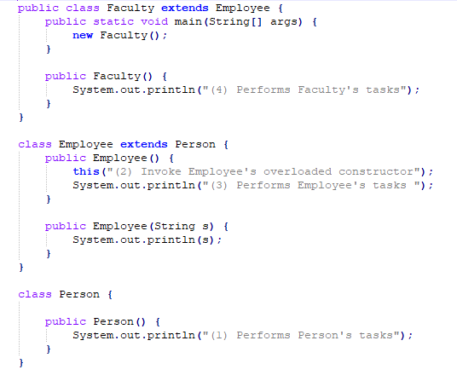
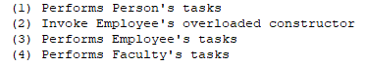
CONSTRUCTOR CHAINING:EXAMPLE
SOURCE
CODE
OUTPUT

Slide 16
CONSTRUCTOR CHAINING:EXAMPLE
The given output is produced under the following order:
The new Faculty() invokes Faculty’s no-arg constructor.
Since Faculty is a subclass of Employee, Employee’s no-arg constructor is invoked before any statements in Faculty’s constructor are executed.
Employee’s no-arg constructor invokes Employee’s second constructor.
Since Employee is a subclass of Person, Person’s no-arg constructor is invoked before any statements in Employee’s second constructor are executed.

Slide 17
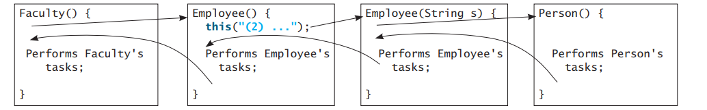
CONSTRUCTOR CHAINING:EXAMPLE
This is summarized on the following diagram:

Slide 18
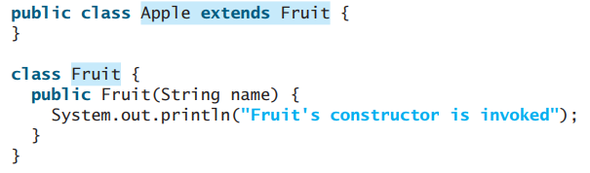
CONSTRUCTOR CHAINING:EXAMPLE
If a class is designed to be extended, it is better to provide a no-arg constructor to avoid programming errors. Consider the following example:
Since no constructor is explicitly defined in Apple, Apple’s default no-arg constructor is defined implicitly.
Since Apple is a subclass of Fruit, Apple’s default constructor automatically invokes Fruit’s no-arg constructor.
However, Fruit does not have a no-arg constructor, because Fruit has an explicit constructor defined. Therefore, the program cannot be compiled.
Notes:
If possible, you should provide a no-arg constructor for every class to make the class easy to extend and to avoid errors.

Slide 19
INHERITANCE: CALLING SUPER-CLASS METHODS
The keyword super can also be used to reference a method other than the constructor in the superclass.
The syntax is:
super.method(parameters);
This can be used to resolve ambiguities when invoking methods of super and derived classes.

Slide 20
INHERITANCE:OVERIDDING METHODS
To override a method, the method must be defined in the subclass using the same signature and the same return type as in its superclass.
A subclass inherits methods from a superclass. Sometimes it is necessary for the subclass to modify the implementation of a method defined in the superclass.
An instance method can be overridden only if it is accessible.
Thus a private method cannot be overridden, because it is not accessible outside its own class.
If a method defined in a subclass is private in its superclass, the two methods are completely unrelated.

Slide 21
INHERITANCE:OVERIDDING METHODS
Like an instance method, a static method can be inherited.
However, a static method cannot be overridden.
If a static method defined in the superclass is redefined in a subclass, the method defined in the superclass is hidden.
The hidden static methods can be invoked using the syntax SuperClassName.staticMethodName.

Slide 22
INHERITANCE:OVERIDDING VS OVERLOADING METHODS
Overloading means to define multiple methods with the same name but different signatures.
Overriding means to provide a new implementation for a method in the subclass.
Overridden methods are in different classes related by inheritance; overloaded methods can be either in the same class or different classes related by inheritance.
Overridden methods have the same signature and return type; overloaded methods have the same name but a different parameter list.
To avoid mistakes, you can use a special Java syntax, called override annotation, to place @Override before the method in the subclass.

Slide 23
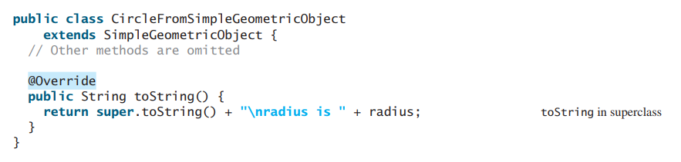
INHERITANCE:OVERIDDING METHODS ANNOTATIONS.
To avoid mistakes, a special Java syntax can be used, called override annotation, to place @Override before the method in a subclass.
This annotation denotes that the annotated method is required to override a method in the superclass.
If a method with this annotation does not override its superclass’s method, the compiler will report an error.

Slide 24
END

